Slide 1


Telangana State Election Data

Slide 2
This Data is all about the Detailed election results for the year of 2014 and 2018 assembly elections in Telangana State Includes: All candidates vote share, votes and voters for each constituency and candidate along with Party and their respective vote share Percentages.
We have obtained this electoral data from the Open City Urban Data Portal for analysis purposes, which is an open platform.
https://data.opencity.in/dataset/telangana-assembly-elections-2018
https://data.opencity.in/dataset/telangana-assembly-elections-2014

Slide 3
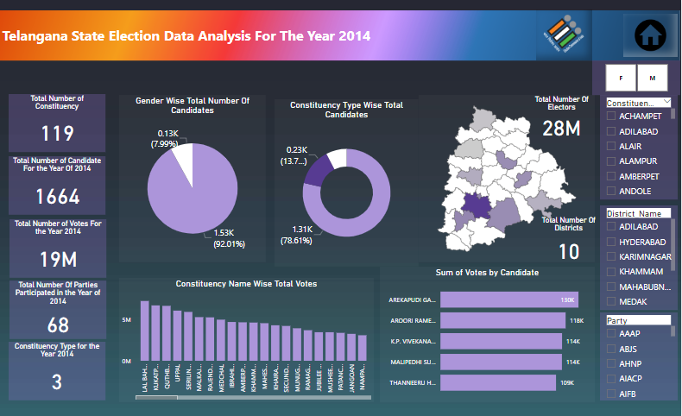

Slide 4
Candidates Registration
Male Candidates
Female Candidates
Others candidates
Constituency Type
2014 : 1664 representing 68 parties.
2018 : 1816 representing 92 parties
2014: 1531(92.01%) of male Candidates.
2018: 1679(92.2%) of male Candidates.
2014: 133(7.99%) of male Candidates.
2018: 140(7.69%) of male Candidates.
2018: only 1 Candidates from others category got participated.
2014: "1312 candidates participated in the General Category (78.61%), 230 in the SC category (13.78%), and 127 in the ST category (7.61%).“
2018: "1447 candidates participated in the General Category (79.46%), while 234 candidates represented the SC category (12.85%), and 140 candidates took part in the ST category (7.69%)."
Voters
2014: 19 million voters participated out of the 28 million eligible voters across 119 constituencies.
2018 : 20 million voters participated.

Slide 5
Constituency with Highest Votes
2014:
Lal Bahadur Nagar in Rangareddy District: 7,274,708 votes.
2018:
Malkajgiri is the top leader with 8,798,958 votes and falls under Medchal-Malkajgiri District
Top 5 parties
2014: Top 5 Parties:TRS, INC, TDP, BJP, IND
2018: Top 5 parties : TRS, INC, TDP, BJP, IND
Top 5 C onstituency for 2014 and 2018
Lal Bahadur Nagar, Malkajgiri, Uppal, Serilingampally, and Quthbullapur emerged as the top 5 constituencies when analyzing their vote share for the years 2014 and 2018.
Candidates with Highest vote
2014 : Arekapudi Gandhi got 130K votes.
2018: Ch. Malla Reddy got 167k highest votes.

Slide 6
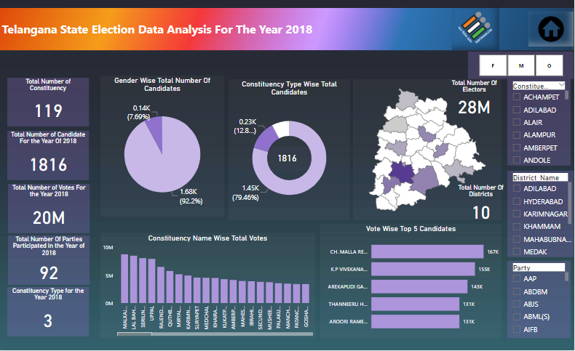

Slide 7
Announcement
of elections
Data of
Candidate Gender Ratio
Counting of
election votes
92.12% of male candidates,7.82% of Female Candidates and 1 % of Other Candidates got participated
May 2014
December 2018
10 Districts, 119 Constituency.
2018: 19.448million Voters
2018: 20.695 million Voters
Candidates nomination phase
Top 5 Parties
Top 5 Constituency
Lal Bahadur Nagar, Malkajgiri, Uppal, Serilingampally, and Quthbullapur
1664 Candidates got participates in 2014.
1816 candidates got participated in 2018.
In 2014 and 2018 among 68 and 92 parties top 5 parties are TRS, INC, TDP, BJP, and IND

Slide 8
Thank You

